Slide 1

Library Management System
Review 2
By:
Khushi Mattu 20BCE1189
Nithish Kanna 20BCE1304
Uditi Gupta 20BCE1445

Slide 2
Architecture Style
We are using DATA CENTERED ARCHITECTURE.
A data store (e.g., a file or database) resides at the center of this architecture and is accessed frequently by other components that update, add, delete, or otherwise modify data within the store.
Client software accesses a central repository which is in passive state.
client software accesses the data independent of any changes to the data or the actions of other client software.
So, in this case transform the repository into a “Blackboard”.
A blackboard sends notification to subscribers when data of interest changes, and is thus active.
Data-centered architectures promote integrability.
Existing components can be changed and new client components can be added to the architecture without concern about other clients.
Data can be passed among clients using the blackboard mechanism. So Client components independently execute processes

Slide 3
Advantages of blackboard data centric architectural style
Provides scalability which provides easy to add or update knowledge source.
Provides concurrency that allows all knowledge sources to work in parallel as they are independent of each other.
Supports experimentation for hypotheses.
Supports reusability of knowledge source agents.

Slide 4
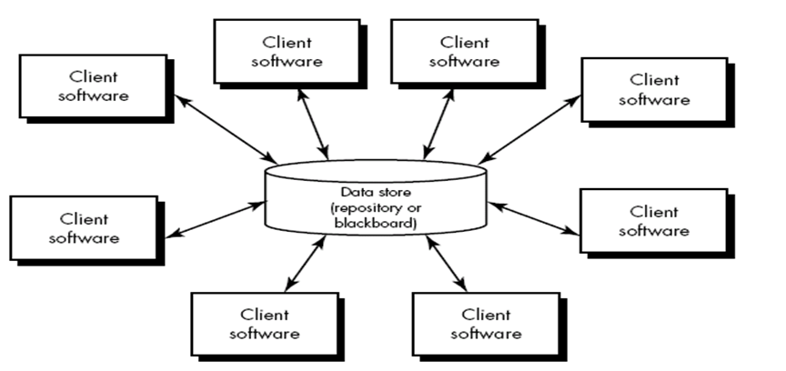

Slide 5
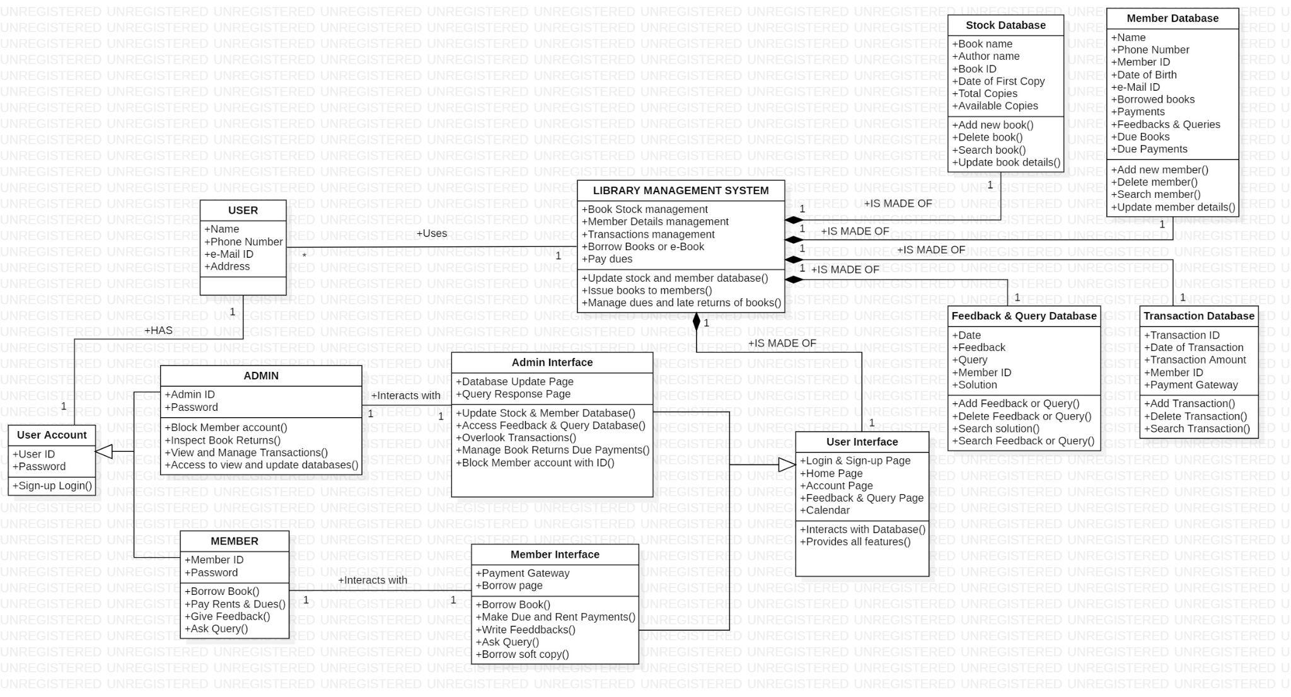
Class Diagram

Slide 6
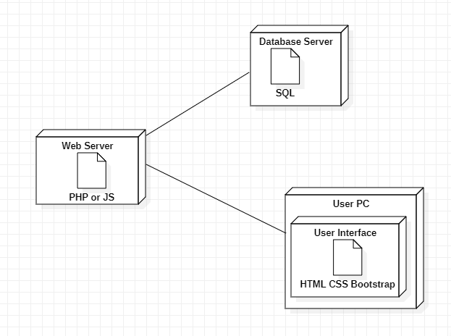
Deployment Diagram

Slide 7
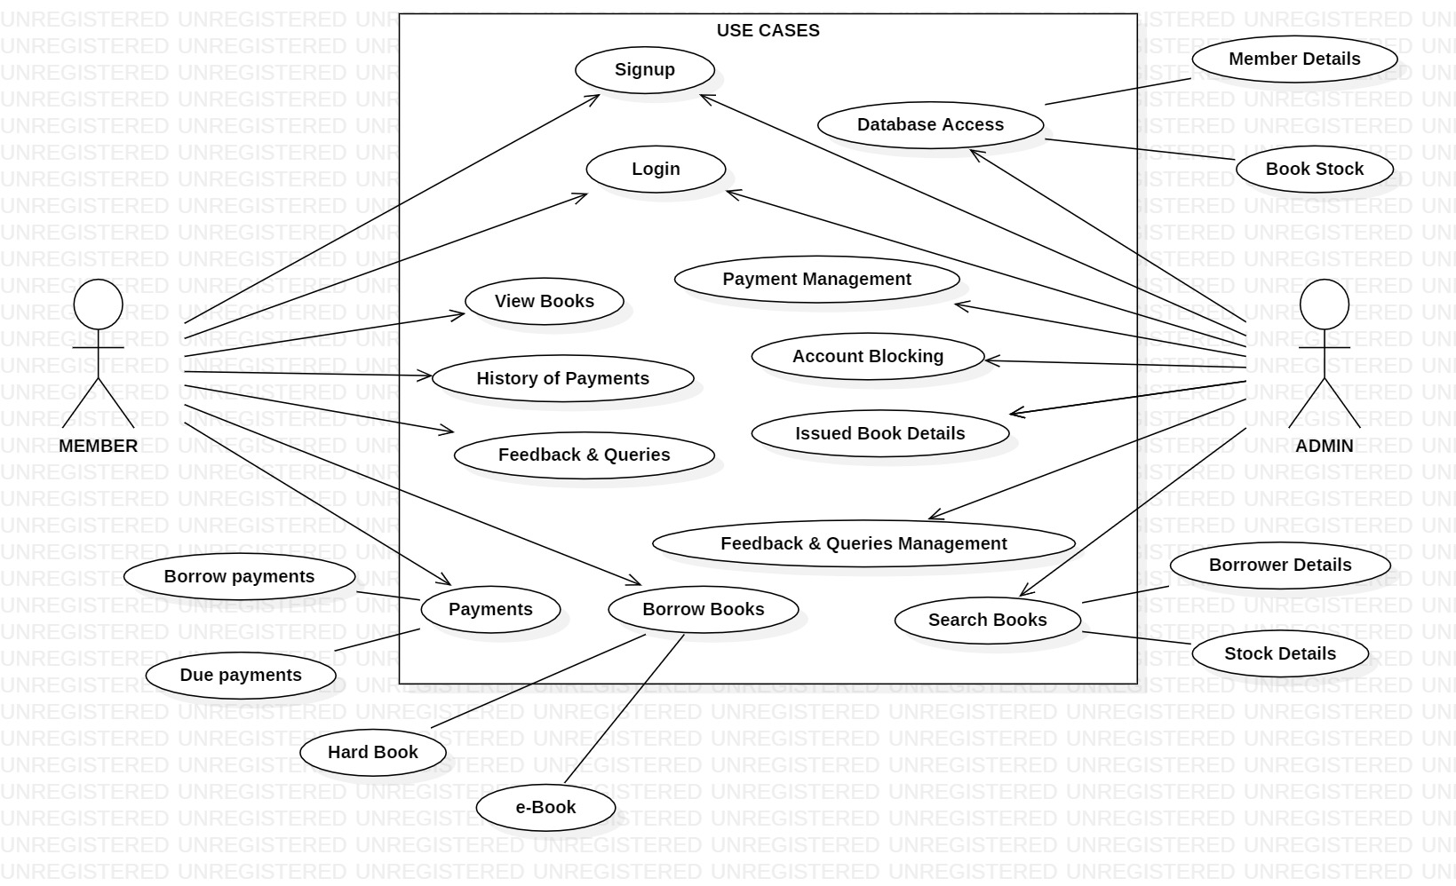
Use case diagram

Slide 8
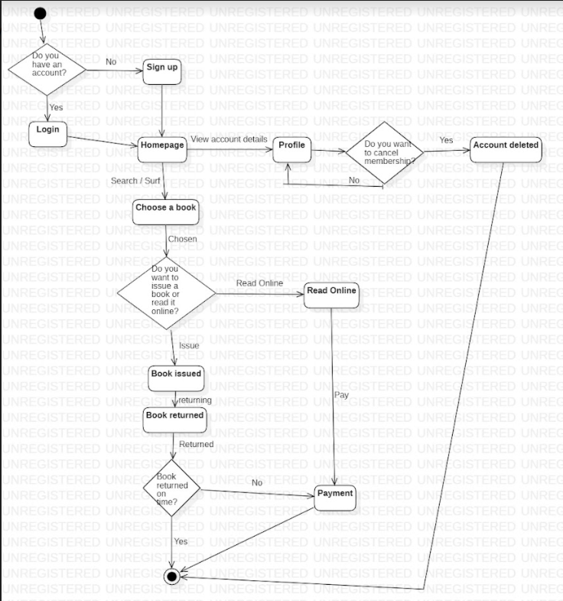
State
Transition
Diagram

Slide 9
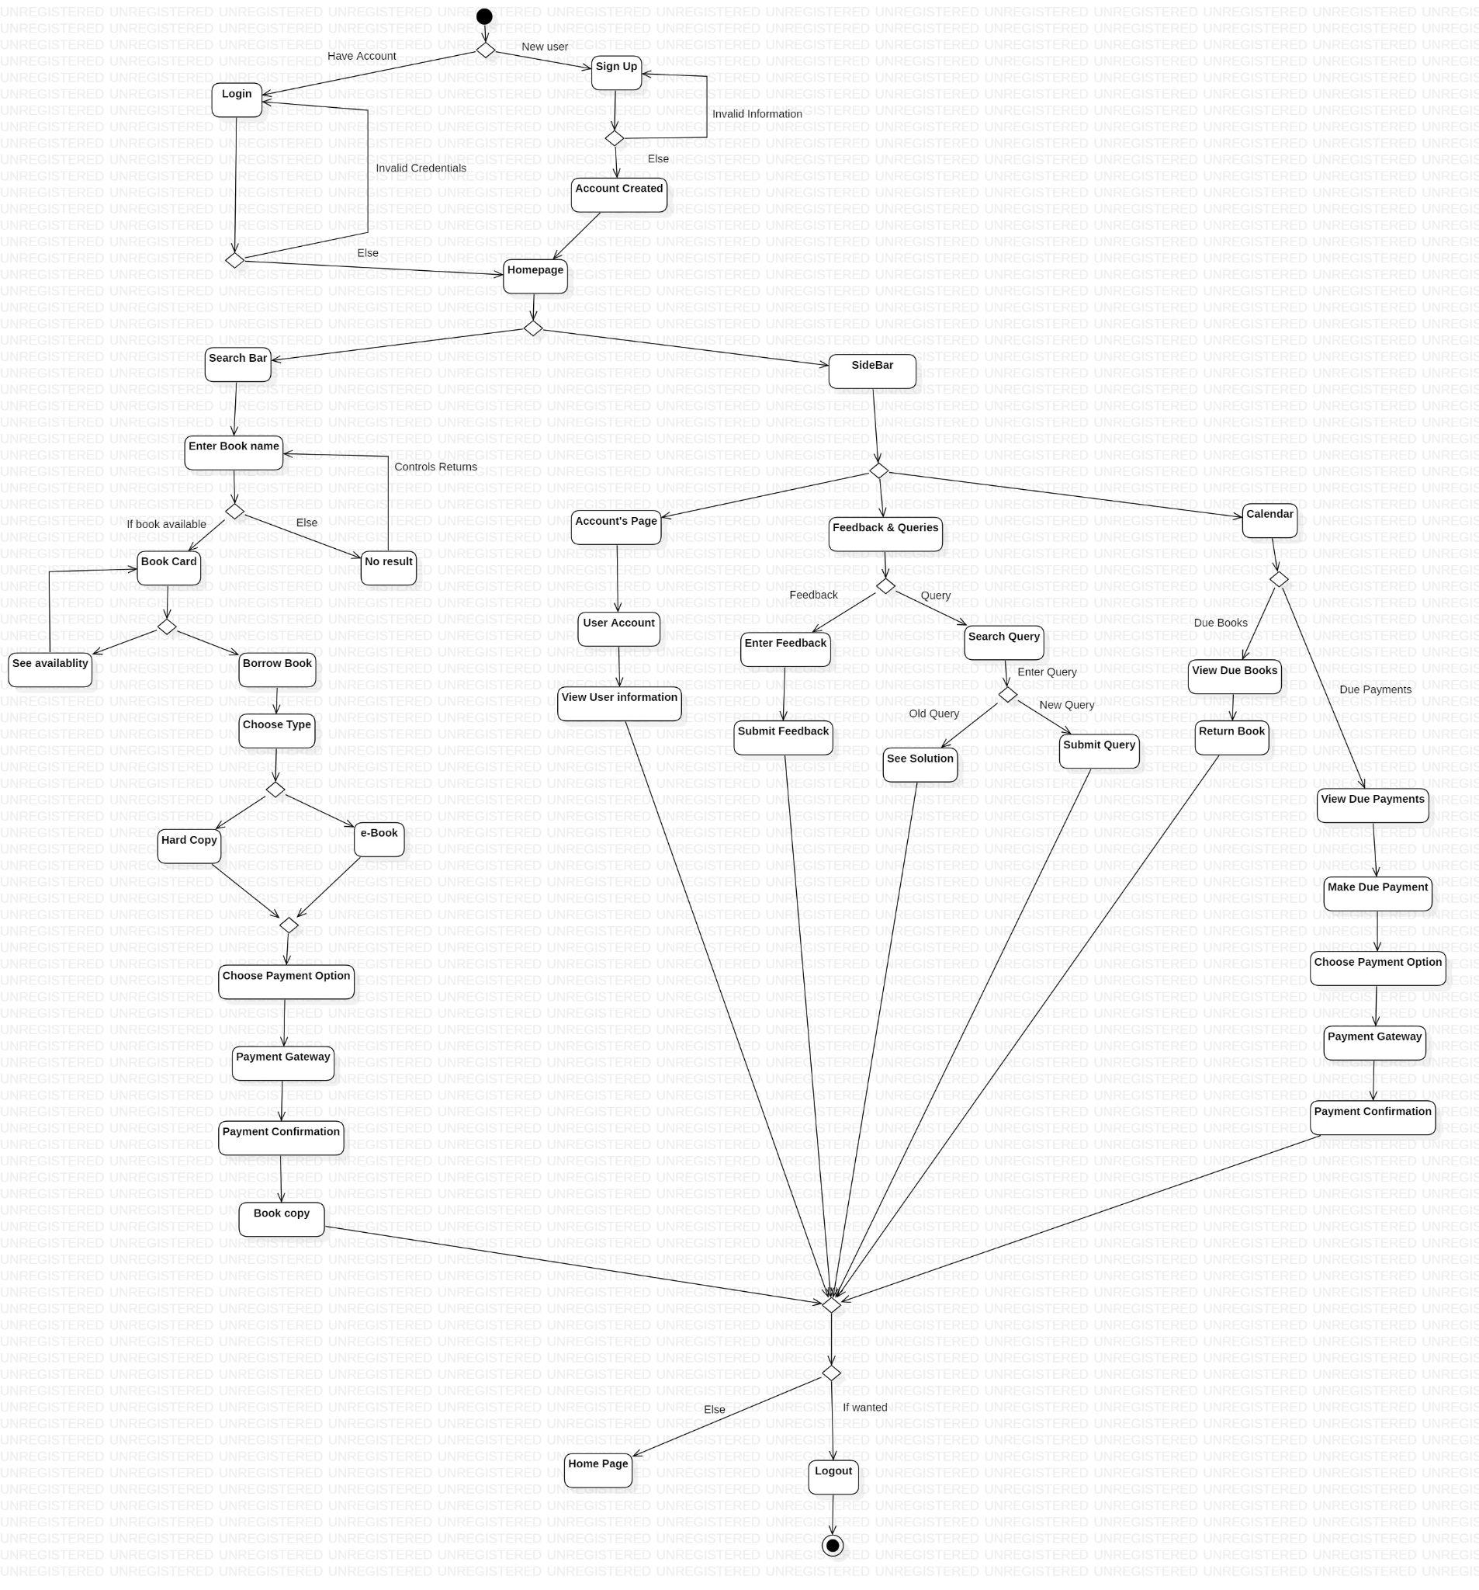
Member Activity Diagram

Slide 10
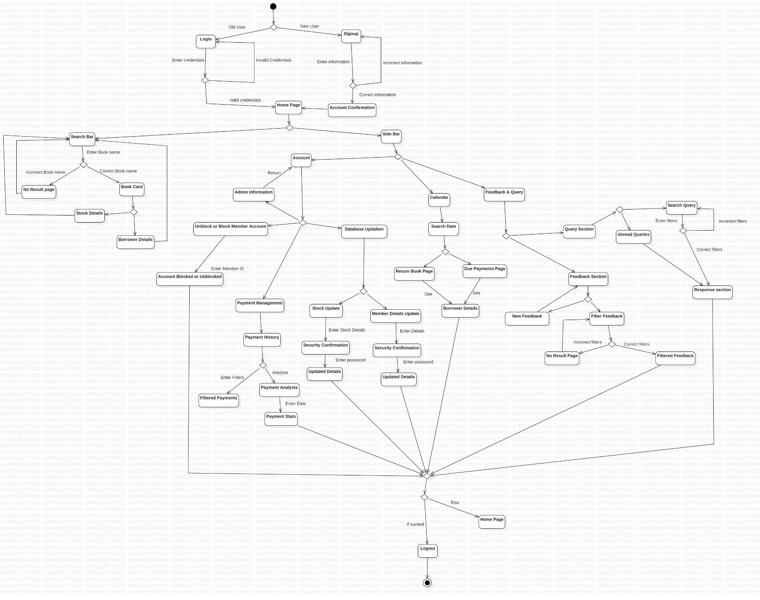
Admin Activity Diagram

